Slide 1
LOAN PRICE PREDICTION using machine learning

Slide 2


5132 - Thirumalai Engineering College
Kilambi, Kanchipuram.
Department of Information Technology
Team member
Name
Register Number
V. VINITH
P. RAMESHKUMAR
I. SABARI
V. GOKUL
513220104009
513220104310
513220104311
513220104306
COORDINATER
MRS.D.JAKULIN SHARMI ME.,

Slide 3
INTRODUCTION
Loans are the core business of banks. The main profit comes directly from the loan's interest.
The loan companies grant a loan after an intensive process of verification and validation. However, they still don't have assurance if the applicant can repay the loan with no difficulties.
We prepared model to predict the target variable. And made a User Interface / web application.

Slide 4
ABSTRACTION
The prediction of loan prices is a critical task in the financial industry, facilitating informed decision-making for lenders and borrowers alike. Traditional methods often rely heavily on historical data and manual assessments, leading to inefficiencies and inaccuracies.
In contrast, machine learning (ML) techniques offer a promising avenue for enhancing loan price prediction by leveraging complex relationships within vast datasets.
The findings provide valuable insights for financial institutions seeking to enhance their loan pricing strategies and mitigate risks effectively.

Slide 5
SCOPE
Predictive the data
Real-time data monitoring
Customer segmentation
Fruad detection
Market forecasting

Slide 6
DATA SET
Finding a specific dataset tailored explicitly for loan price prediction can sometimes be challenging due to the sensitive nature of financial data.
However, there are several publicly available datasets related to lending and credit risk assessment that you can use for building machine learning models to predict loan prices.

Slide 7
Existing System
As of last update in January 2022, there are various existing systems and applications that leverage machine learning (ML) for loan price prediction in the financial industry. While I can't provide real-time information.
These existing systems typically leverage a combination of supervised learning, unsupervised learning, and reinforcement learning techniques to predict loan prices accurately.
They often require large datasets, sophisticated algorithms, and domain expertise to deliver reliable predictions and meet regulatory requirements. Additionally, ongoing model monitoring, validation, and refinement are essential to maintain model accuracy and effectiveness over time.

Slide 8
Proposed System
To overcome the drawbacks of the existing system, the proposed system has been evolved.
Aggregate and Integration the diverse datasets, covering cases, loan information.
These project more developed an interactive dynamic visualization dashboard.
The system provides with the best user interface. The efficient reports can be generated by using this proposed system.

Slide 9
System Requirements
Hardware Requirements
1.Minimum RAM: -4GB
2.Hard Disk: -128 GB
3.Processor: -Intel Pentium 5 or higher.
Software Requirement
1. OS: windows
2. Python IDE: Python 2.7.x and above
3.Jupyter Notebook
4.Visual Studio Code
5. Language: Python

Slide 10
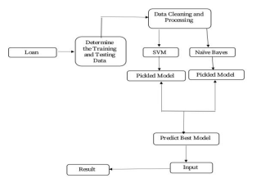
Architecture

Slide 11
DATA FRAMES
It is the crucial components in loan price data prediction project.
They help organize and manipulate data efficiency.
Python library packages like NumPy, pandas are used for this purpose.
Data Frames accepts many different kinds of inputs.

Slide 12
MODULES
Module 1: Cleaning the dataset
Module 2: Frame the problem
Module 2: Data preprocessing
Module 3: Computing Accuracy
Module 4: Model Deployment

Slide 13
ALGORITHM
It is a statistical model that in its basic form uses a logistic function to model a binary dependent variable, although many more complex extension exist.
In regression analysis, logistic regression(1) (or logit regression) is estimation the parameters of a logistic model (a form of binary regression ).
Mathematically ,a binary logistic model has a dependent variable with two possible values ,such as pass fail which is represented by an indicator variable, where the two values are logistic regression.
Supervised Learning Technique.
Correlation Outperformance PCA (Principal Component Analysis) at low features.
Has a 94.6% accuracy for high features count. Doesn’t exhibit overfitting

Slide 14
PYTHON PACKAGES
There are several Python packages commonly used for loan price prediction project.
NumPy: For simple arrays.
Pandas: For reading the file.
SciKit: Learn- for pre-processing.
Matplotlib or Seaborn: For plotting and representing confusion matrix color format.
Tensor flow: For matrix format.

Slide 15
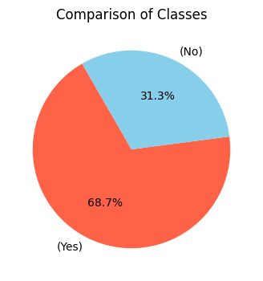
COMPARISON CLASSES

Slide 16
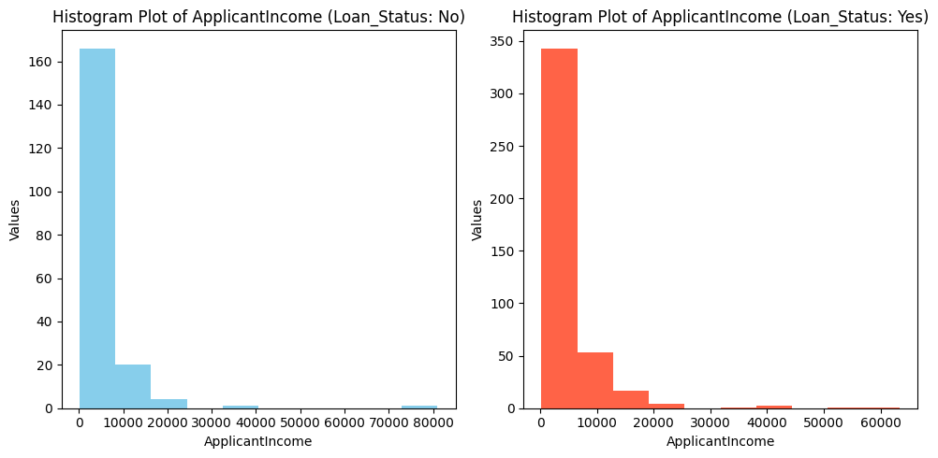
APPLICATION INCOMES

Slide 17
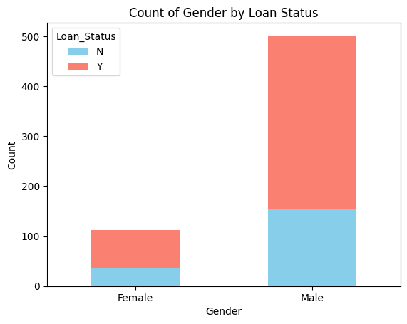
GENDER WISE FOR LOAN STATUS

Slide 18
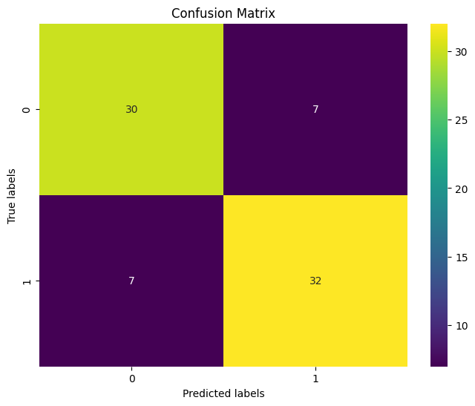
CNFUSION MATRIX

Slide 19
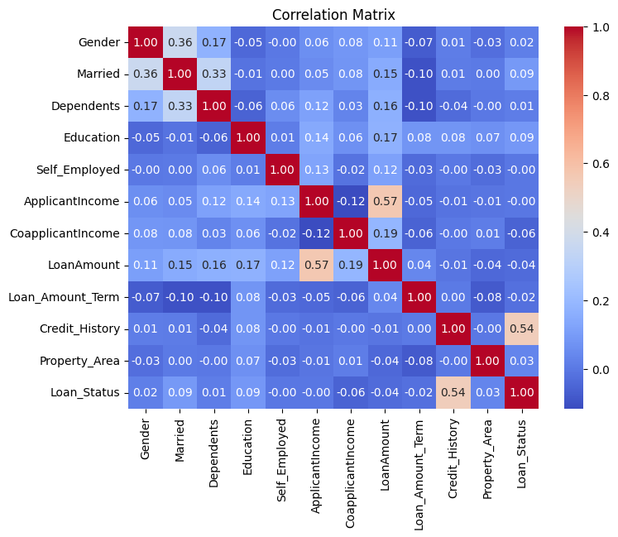
CORRELATION MATRIX OR HEAT MAP

Slide 20
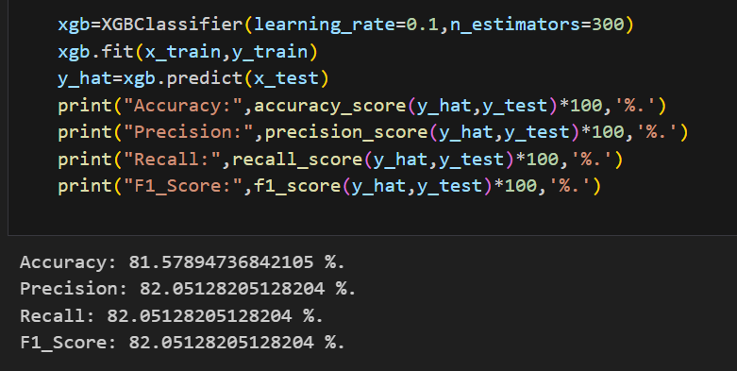
ACCURACY

Slide 21
Feature Enhancement
Dynamic price prediction
Fully customization
Real-time data integration
Integrate loan prices
Global monitoring systems

Slide 22
Conclusion
From the Exploratory Data Analysis, we could generate insight from the data. How each of the features relates to the target. Also, it can be seen from the evaluation of three models that Logistic Regression performed better than others, Random Forest and Decision Tree.
The conclusion about loan price prediction using machine learning (ML) depends on various factors such as the quality of the data, the features used in the model, the algorithm chosen, and the evaluation metrics employed.

Slide 23
Reference
1. "Loan Approval Prediction Using Machine Learning Techniques" by Varun Sharma, Shubham Jain, Shivam Bansal, and Tanuj Jain. This paper explores the use of various machine learning algorithms such as Decision Trees, Random Forests, and Gradient Boosting Machines for loan approval prediction.
2. "A Comparative Study of Machine Learning Algorithms for Loan Default Prediction" by Akshay Verma, Kshitij Chhajer, and Bhargavi Paranjape. This study compares the performance of different machine learning algorithms including Logistic Regression, Support Vector Machines, Random Forests, and Gradient Boosting Machines for loan default prediction.
3. "Predicting Loan Repayment with Machine Learning Algorithms" by Sangeeta Agrawal, Ramkumar Rajendran, and Sunita Soni. This research paper investigates the application of machine learning techniques such as Neural Networks, Support Vector Machines, and Decision Trees for predicting loan repayment.
4. "Machine Learning Approaches for Credit Scoring: A Comparison of Traditional and Non-Traditional Models" by M. Haji Mirsadeghi, R. Akbari, and M. Nazemi Ardakani. This paper compares traditional credit scoring models with machine learning approaches for credit risk assessment, including loan price prediction.

Slide 24


